Slide 1

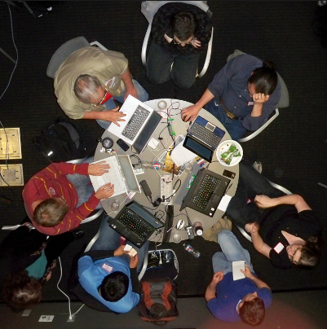


Why Git & Github?
Why would Git/GitHub interest me? An introduction.
James R. Small, Sr. Infrastructure Architect
Notes:
A little about me – I’ve worked full time in IT since ‘95, including Compute with UNIX, NetWare, Windows, Linux and BSD, Virtualization primarily with VMware and Networking predominantly with Cisco and Open Source; lately I’ve gotten back into scripting and am trying to ramp up on Python; that journey led me to PyOhio in July and my first sprint – more about that later
Time: 1:15

Slide 2
Yet another tool??? Why git/github?
I have no time and too many tools
Why would I even consider looking at Git/GitHub?
What problems do these tools solve?
Notes:
Let’s start with the why – why Git and GitHub? What problems do they solve?
Time: 2:30

Slide 3
common problems
I changed (a) program/script/configuration/markup/markdown file(s) and something broke – how do I revert to the last working version?
I need to test a new feature/option without breaking the main/production version
We have a team working on code/configuration/markup and need to know who did what
Notes:
These problems are designed to be solved by a version control system
Time 3:45

Slide 4
problems solved by Git
Git can:
Lets me easily version or “checkpoint” files
Each checkpoint time and date stamped
Includes comments on what changed
Allows diff between versions to see exact changes
Allows rolling back to previous versions
Notes:
Time: 5:00

Slide 5
problems solved by Git
Git allows branching:
Lets me easily duplicate my entire file based setup as a new branch
I can easily switch back and forth between branches (e.g., production and test)
I can easily try things out without breaking production
If I like something I can easily merge it back in, if not I can easily discard
Notes:
For example – let’s say I have a baseline configuration; I also want an experimental lab branch, a production branch and a future branch
This keeps operations, engineering and planning all happy
Time: 6:15

Slide 6
problems solved by Github
GitHub is a shared storage for Git:
Allows a team of people to easily collaborate on a project
I can easily see who did what
I can track feature requests/bugs
I can integrate automatic testing – every time someone checks in a change it will be tested with the results shown (Continuous Integration)
Notes:
Of course for anything to be good there has to be a cloud element, right? ☺
Not only can I collaborate with other people, I can collaborate with myself or easily stay synchronized with multiple devices!
Time 7:30

Slide 7
why git/github over other solutions
Git/GitHub may be interesting, but why these tools over other similar ones?
Notes:
I can’t claim to be a versioning or distributed source management expert, but; there is something in numbers; If the majority of people use and are fairly happy with a solution, there must be something to it.
Time: 8:45

Slide 8
who uses Git/Github?
the Linux Kernel
Ruby on Rails
Bootstrap
Node.js
JQuery
D3
Homebrew
vim!!!
GitHub Repository Ranking
Notes:
Time: 10:00

Slide 9
whither git/github?
Managing large projects – code, web sites, infrastructure – with a (potentially large) team is not easy
Distributed Source/Version Control Systems tackle this challenge
In 2005 the best option (according to Linux Torvalds) was BitKeeper but it was proprietary and had some limitations
Notes:
Time: 11:15

Slide 10
whither git/github?
A spat between the Linux Kernel Developers and BitKeeper resulted in Mr. Torvalds creating a new system from scratch – git – after all, how hard could it be? ☺
Torvalds quipped about the name git (which means "unpleasant person" in British English slang): "I'm an egotistical bastard, and I name all my projects after myself. First 'Linux', now 'git'."
Notes:
Andrew Tridgell started to reverse engineer the BitKeeper protocol - a violation of the terms to use it for free for open source. That resulted in Larry McVoy, the owner of BitKeeper and Andrew getting into a spat. Although Linus found source control management completely uninteresting, the BitKeeper showdown ultimately led Linus to decide the current version control system wouldn’t work and that he needed to develop a replacement. He then proceeded in short order to whip out git with a version accepting a kernel commit within ten days. Necessity is truly the mother of motivation! ☺
Time: 12:30

Slide 11
whither git/github?
A few years after Git’s creation, GitHub came along
Essentially a centralized cloud repository (shared storage) for git projects with a nice Web front end
Also adds issue tracking, task management, wikis and is free for public projects
The largest host of source code in the world
Notes:
Time: 13:45

Slide 12



obtaining git
Download the free client
git-scm.com/downloads (CLI)
git-scm.com/download/guis (GUI)
Notes:
For Windows, you need to download the client
For OS X/MacOS its built-in – to use a newer version you can download one and update your path or use something like homebrew
For Linux, its also built-in; the recommendation for updating is to use the system package manager
Time: 15:00

Slide 13
Git documentation
git-scm.com/docs (git reference page)
git pdf cheat sheet
git visualization cheat sheet
git-scm.com/book (Pro Git 2nd ed, free!)
Notes:
Time: 16:15

Slide 14
Git – getting started (Local)
Start locally
mkdir test
cd test
# Initialize git – one time deal
git config --global user.name "James R. Small"
git config --global user.email james.r.small@example.com
# Check config: git config -l
# Start a local repository
# (directory with versioning/checkpointing)
git init
# Creates .git directory
Notes:
Time: 17:30

Slide 15
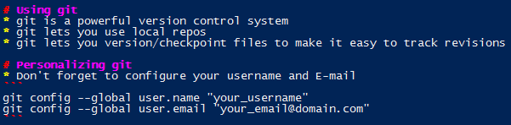
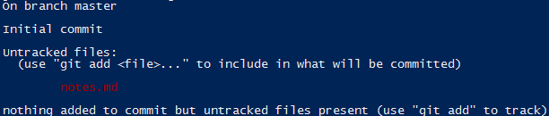
Git – getting started (local)
Local Repository (Repo)
# In test directory where .git directory is
# Create new file to be versioned:
vim notes.md
# What’s the status of the file? Check at any time:
git status
Notes:
Files start out as untracked – to version/checkpoint files, use git add <file>
Anyone familiar with markdown? Why would I use it?
Time: 18:45

Slide 16
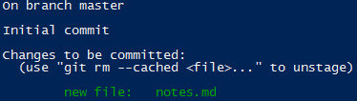
Git – getting started (local)
Local Repository (Repo)
# Check in (version) file with git add:
git add notes.md
# File is now staged – status:
git status
#Commit changes to local repo:
git commit –m “Initial commit”
[master (root-commit) 7b23067] Initial commit of my notes
1 file changed, 13 insertions(+)
create mode 100644 notes.md
Notes:
I stage a file because I can stage a group of related files. When I do a commit, everything that’s staged is committed. From what I’ve heard, best to do these as separate steps.
Note: The “7b23067” value is the first 7 digits of the SHA-1 hash for this commit – this will be used later
SHA-1 is a cryptographic hash function – it takes data of arbitrary size and produces a fixed-length 40 byte hash or message digest; the point of a cryptographic hash function is it fairly quickly creates a digest which should uniquely identify the data fed into the hash function; at the same time reversing this process (finding data that results in the same hash value) is very difficult; in addition – a small change in the original data fed into the cryptographic hash function will result in a substantially different hash value; It should be noted though that many weaknesses have been found with SHA-1 such that it should no longer be considered cryptographically secure; Thus it’s probably OK to use it as a unique key for each piece of data (file) committed into a git repo, but it shouldn’t be thought of as secure; from public cryptanalysis, SHA-1 is estimated to have a collision with 2^60 tries or about 1 in 1.1 quintillion tries.
Time: 20:00

Slide 17

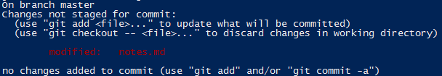
Git – getting started (local)
Local Repository (Repo)
# Current status:
git status
# Make some changes
vim notes.md
# Status?
Notes:
Notice the status is now “clean” or all tracked files are up to date and committed; as soon as changes are made git will report a status of modified with “unstaged” changes
Time: 21:15

Slide 18
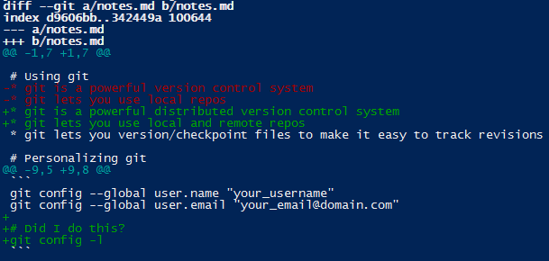
Git – getting started (local)
Local Repository (Repo)
# What changed in the file?
git diff
“-” = Previous version of file
“+” = New version of file
Notes:
Time: 22:30

Slide 19
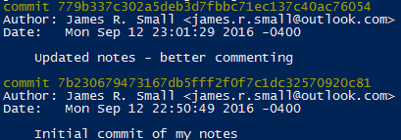
Git – getting started (local)
Local Repository (Repo)
# Commit new changes
git add notes.md
git commit -m “Updated notes - better commenting”
[master 779b337] Updated notes - better commenting
1 file changed, 5 insertions(+), 2 deletions(-)
# History of changes:
git log
Notes:
Time: 23:45

Slide 20
Git – getting started (local)
Local Repository (Repo)
# Revert to previous version - # is SHA hash from git log
git reset --hard 7b23067
HEAD is now at 7b23067 Initial commit of my notes
# Back to original version
more notes.md
Notes:
Note 1: The “7b23067” is the same starting 7 characters of the commit’s SHA-1 hash has that we noted before when doing the original commit
Note 2: Using branches would probably be a better way to deal with this – more in a bit
Time: 25:00

Slide 21
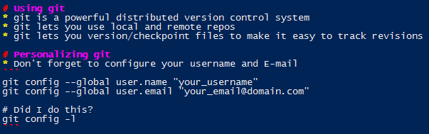
Git – getting started (local)
Local Repository (Repo)
# Wait - I changed my mind again and want to switch back!
git reflog
7b23067 HEAD@{0}: reset: moving to 7b23067
779b337 HEAD@{1}: commit: Updated notes - better commenting
7b23067 HEAD@{2}: commit (initial): Initial commit of my notes
git reset --hard 779b337
HEAD is now at 779b337 Updated notes - better commenting
more notes.md
Notes:
Time: 26:15

Slide 22

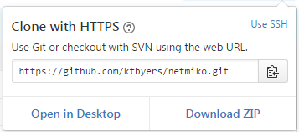
Git – getting started (remote)
Start with remote repo
Search GitHub for the project repo you want:
In the project repo, click on the Clone or download button:
Copy the URL:
Notes:
Time: 27:30

Slide 23
Git – getting started (remote)
Start with remote repo
Paste the copied URL into the terminal after git clone:
git clone https://github.com/ktbyers/netmiko.git
Cloning into 'netmiko'...
remote: Counting objects: 4244, done.
remote: Compressing objects: 100% (11/11), done.
remote: Total 4244 (delta 2), reused 0 (delta 0), pack-reused 4233
Receiving objects: 100% (4244/4244), 756.93 KiB | 0 bytes/s, done.
Resolving deltas: 100% (2759/2759), done.
Checking connectivity... done.
# You now have a complete local copy of the project
# to play with...
Notes:
Note: This is the most simple remote case – next we’ll talk about group collaboration
Time: 28:45

Slide 24
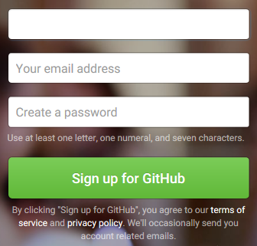
Github – getting started
Open your favorite browser and navigate to github.com – sign up for an account, it’s free:
Notes:
Time: 30:00

Slide 25

Github – getting started
Once you’re logged in to GitHub, navigate to:
github.com/sockduct/intro_to_sprinting
In the upper right hand corner, you’ll see a “Fork” Icon – click on it to make a copy of the repo in your GitHub account:
Note: This is based on Chalmer Lowe’s Intro_to_Sprinting Project
Notes:
What’s a sprint?
Time: 31:15

Slide 26

Github – getting started
Once you fork a copy of this repo, you’ll see a link under it referring back to the original. In my case, it points to Chalmer Lowe’s repo. In your case, it will point to my repo: (why?)
After forking the repo, from your system do a git clone:
https://github.com/<your_github_id>/intro_to_sprinting.git
Notes:
Difference between forking and cloning?
Time: 32:30

Slide 27
Git/Github – collaboration workflow
Cloning the repo on your system allows you to make changes:
# Edit the authors.md file
vim authors.md
# Add your name to the list of authors
# Checking with git status, you’ll see the
# authors.md file needs to be checked in:
git add authors.md
git commit -m “Added my name to authors file”
Notes:
Time: 33:45

Slide 28
Git/Github – collaboration workflow
Now that you’ve made a change to the authors.md file and committed it, you need to push these changes back to your GitHub repo:
git push origin master
When you clone a repo, it creates an alias called origin that points to where you cloned the repo from:
git remote -v
Notes:
Two things to notice with the git push: pushing to origin which is an alias for the URI where you cloned the repo from, the other thing of note is master which is the branch you’re using, master is the default branch
Time: 35:00

Slide 29

Git/Github – collaboration workflow
Back on your GitHub repo page, you can now submit a Pull Request (PR). This lets you submit your changes back to the author’s repo (the one you cloned from):
Make sure the base fork is sockduct/intro_to_sprinting and the head fork is your repo
Make sure you get a green check mark and "Able to merge" (what happens if there are conflicts?)
Notes:
Time: 36:15

Slide 30
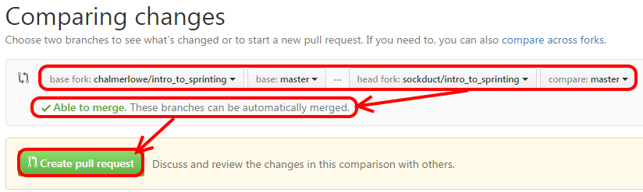
Git/Github – collaboration workflow
Click on "Create pull request:"
Notes:
One thing that can be a little confusing – a git “pull” and a GitHub “Pull Request” or PR are totally different; a git pull instructs git to retrieve any changes from the source specified on the branch specified; a GitHub Pull Request signals a repo maintainer that you made some changes and would like her to merge the changes back into her repo
Time: 37:30

Slide 31
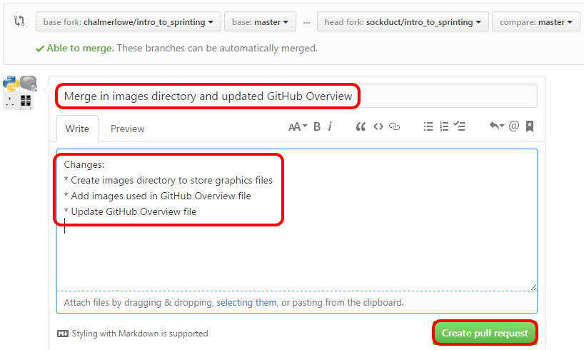
Git/Github – collaboration workflow
Next, Write a summary title describing the changes
Write a brief description of what you're changing in this pull request
Click on "Create pull request:"
Notes:
Time: 38:45

Slide 32
Git/Github – collaboration workflow
Finally, the repo owner you forked from will see the PR (Pull Request). If there are no conflicts and it makes sense, generally they will accept it which merges the changes in.
Congratulations on participating in the Open Source process!
Notes:
Time: 40:00

Slide 33
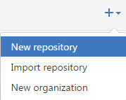
Github – Creating your own repo
From your GitHub account, in the upper right corner click on the “+” Icon and select “New Repository”:
Notes:
Time: 41:15

Slide 34
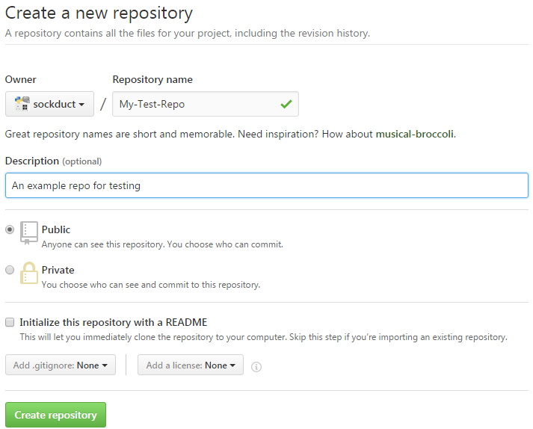
Github – Creating your own repo
Choose a repo name, a comment and click “Create repository”:
Notes:
Time: 42:30

Slide 35
Git/Github – own repo workflow
From your system, clone the repo with git:
git clone https://github.com/<your-github-id>/My-Test-Repo.git
Make changes, commit, push, repeat...
Notes:
Time: 43:45

Slide 36
Git/Github – workflow questions
Can’t I just create the GitHub repo from git so I can use one tool?
Why use GitHub if it’s just me?
What’s a private repo? What’s the difference between private and public?
Notes:
Answers – no, can’t use git to create GitHub repo, but GitHub does have a published API so you could write a script or program to create a GitHub repo; why use a GitHub repo? Several pros – it’s a cloud backup, it’s a cloud resume, it makes it easy for other people to collaborate with you, other people may find and take an interest in your work including contributing cool new features!; what’s the difference between a private and public repo? Public is free but everyone can see/copy, maybe OK for your casual code/files but probably not OK for work or sensitive info – for that there are private repos which are only visible to people you explicitly give persmission to, the catch is this costs money in the form of a monthly fee
Time: 45:00

Slide 37
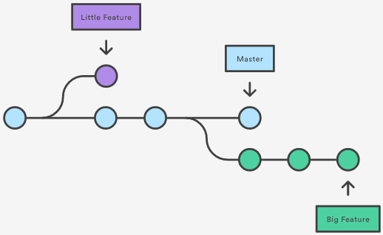
Git/Github – branches
Braches are a way to essentially create a copy of your repo (project) for experimentation, testing or new features. The idea is to develop in the new branch without impacting the main branch:
Notes:
Time: 46:15

Slide 38
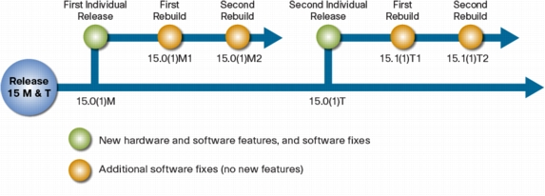
Git/Github – branches, Examples
For example, Cisco - a major infrastructure vendor - uses branches for its IOS software releases:
Notes:
Time: 47:30

Slide 39
Git/Github – branches, Example
From your git clone of your GitHub test repo:
git branch
* master
# This is showing us there is only one branch named “master” which is the default
git branch simple
# Create a new branch named “simple”
git branch
* master
simple
Notes:
Now we have two branches – master and simple, the asterisk shows us that we’re in branch master
Time: 48:45

Slide 40
Git/Github – branches, Example
Use another branch:
# Switch branches from master to simple:
git checkout simple
Switched to branch 'simple'
# Revert to origin notes file in branch simple
git reflog
(...)
7b23067 HEAD@{#}: commit (initial): Initial commit of my notes
# Find initial commit, # will be some number, revert:
git reset --hard 7b23067
Notes:
Time: 50:00

Slide 41
Git/Github – branches, Example
But, we haven’t thrown away the updated version:
# Switch branches from simple to master:
git checkout master
Switched to branch ‘master'
Check file again – it’s the “updated” version:
Note: To delete a branch: git branch –d <branch>
Notes:
So now we have both versions – the simple, original version in the simple branch and the updated version in the master branch
Time: 51:15

Slide 42
Git/Github – Push repo to github
I have a local repo with multiple branches. What if I want to push it to GitHub?
Recommendation: Create a repo on GitHub with the same name as your local repo directory
Configure local repo to use GitHub repo and push/sync it:
git remote add origin https://github.com/<your_github_id>/test.git
git push origin master
Username for 'https://github.com': <your_github_id>
Password for 'https://sockduct@github.com': <your_github_password>
Notes:
Time: 52:30

Slide 43
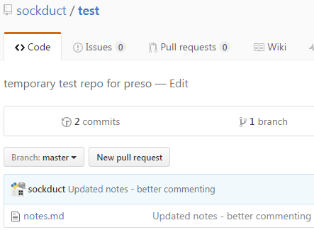
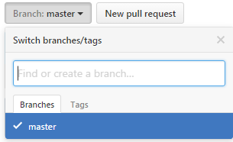
Git/Github – Push repo to github
Look on GitHub:
But – where’s the simple branch?
Notes:
Time: 53:45

Slide 44
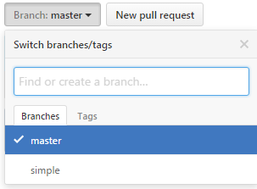
Git/Github – Push repo to github
Remember – have to push each branch:
git push origin simple
Now Check GitHub repo again – may have to refresh page:
Notes:
Time: 55:00

Slide 45
Git/Github – collaboration
What if I clone a repo on GitHub, make some changes, submit a PR and discover there’s a conflict?
You should plan to resolve the conflict yourself, it’s unlikely the repo owner will do it for you:
# You used git to clone your repo
git remote –v
origin https://github.com/<your_github_id>/intro_to_sprinting (fetch)
origin https://github.com/<your_github_id>/intro_to_sprinting (push)
# You need to pull updates from the original repo
git remote add upstream https://github.com/sockduct/intro_to_sprinting
Notes:
Time: 56:15

Slide 46
Git/Github – collaboration
Now, sync with the original (upstream) repo:
# Assuming master branch:
git pull upstream master
Resolve any merge conflicts and push the changes back to your repo
Now, re-submit a PR and there shouldn’t be any conflicts
Notes:
Time: 57:30

Slide 47
Git/Github – call to action
Install git – Windows, OS X, Linux
Setup a GitHub account
Fork intro_to_sprinting repo from my account (github.com/sockduct/intro_to_sprinting)
Clone this repo to your system with git
Add yourself to the authors file
Push the change back to your GitHub repo
Open a PR for me to accept the change
Start using git/GitHub for projects!
Notes:
Time: 58:45

Slide 48




Questions
?
@sockduct
github.com/sockduct
Notes:
Time: 60:00 reach this slide, quickly show appendices and then take questions if time

Slide 49
Appendix

Slide 50
git quick help
From any operating system:
CLI
git --help
git <command> --help
(e.g., git config --help)
CLI, but launches web or man page:
git help git
git help <command>
(e.g., git help config)
CLI – main commands:
git [add | am | archive | bisect | branch | bundle | checkout | cherry-pick | citool | clean | clone | commit | describe | diff | fetch | format-patch | gc | grep | gui | init | log | merge | mv | notes | pull | push | rebase | reset | revert | rm | shortlog | show | stash | status | submodule | tag | worktree]

Slide 51
for your reference
Git Info
Client Home Page
Documentation
Pro Git Book
GitHub Info
Understanding the GitHub Flow
Explore GitHub - Project Showcases
Viewing Contributions on Your Profile Page
GitHub Guides
GitHub Training & Guides on YouTube
GitHub Help

